Slide 1

Department of Computer Science and Engineering
Introduction
to
Microprocessors
BRAC University
Course ID : CSE 341
Course Title : MICROPROCESSORS

Slide 2
Instructors
Aminul Huq
Lecturer, Department of Computer Science & Engineering
Saadat Hasan Khan
Lecturer and Lab Coordinator, Department of Computer Science & Engineering
Ramkrishna Saha
Lecturer, Department of Computer Science & Engineering
Sifat Tanvir
Lecturer, Department of Computer Science & Engineering
Ragib Morshed
Lecturer, Department of Computer Science & Engineering
Syed Zamil Hasan Shoumo
Lecturer and Theory Coordinator, Department of Computer Science & Engineering

Slide 3
Topics to be Covered
Microprocessors and Microcontrollers
Applications of microprocessors and microcontrollers
Intel 8086 Microprocessor: Internal architecture, Register structure, Addressing modes, Instruction set etc.
An overview of Intel 80186, 80286, 80386, 80486 and Pentium microprocessors
RISC and CISC processors.
Coprocessors.
Assembly language programming

Slide 4
Recommended Texts
Microprocessors and Interfacing: Programming and Hardware, by Douglas V. Hall
Assembly Language Programming and Organization of the IBM PC, by Ytha Y. Yu, Charles Marut
Microprocessor, architecture, programming & application with the 8085, by Ramesh Gaonkar
The Intel Microprocessor, by Barry B. Bray
Microprocessor and Microcomputer – Based System Design, by Mohamed Rafiquzzaman

Slide 5
Some tips before we begin
Number Systems and their Conversion
Basics of “Digital Logic Design”
Basics of “Computer Architecture”
Basic Programming

Slide 6
Concept of Computer
Data Processing
Computer
Data Storage

Slide 7
Major Components of Computer
MEMORY
I/O
SYSTEM BUS
Computer
CPU

Slide 8
Central Processing Unit
A central processing unit (CPU) is a description of a class of logic machines that can execute computer programs.
The form, design and implementation of CPUs have changed dramatically since the earliest examples, but their fundamental operation has remained much the same.

Slide 9
Central Processing Unit
To synchronize and control the
overall operation of the CPU
Control Unit & Instruction Decoder
To decode instruction and
pass the necessary control signals to CU
To perform the arithmetic and logical
operations within the CPU
Arithmetic/Logic Unit
A set of internal storage
locations within the CPU
To perform shift and rotate
operations that may either be
arithmetic or logical in nature
Registers
Control and Status Registers
User-Variable Registers

Slide 10
So .. What is Microprocessor?
A microprocessor (abbreviated as µP) is a Silicon Chip that contains an electronic central processing unit (CPU). In the world the word µP or CPU is now used interchangeably. It is made from miniaturized transistors and other circuit elements on a single semiconductor integrated circuit (IC).
The integration of the whole CPU onto a single VLSI Chip therefore greatly reduced the cost of processing capacity.
Architectures of Microprocessors:
RISC (Reduced Instruction Set Computer)
CISC (Complex Instruction Set Computer)
Special-purpose designs: Microcontrollers, Digital Signal Processors (DSP) and Graphics Processing Units (GPU).

Slide 11
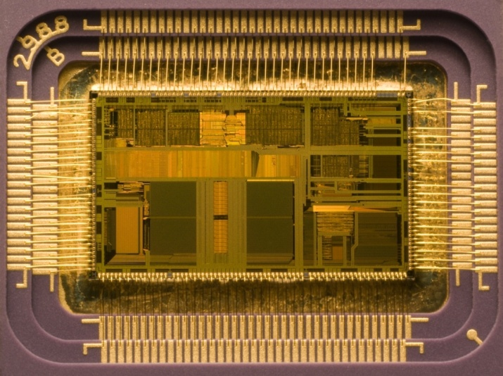
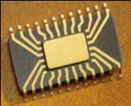
Concept about Microprocessor
A microprocessor incorporates most or all of the functions of a central processing unit (CPU) on a single integrated circuit (IC).
Die of an Intel 80486DX2 microprocessor (actual size: 12×6.75 mm) in its packaging
CPU

Slide 12
List of Microprocessors
1971 - Intel 4004, 1st single chip CPU, 4-bit processor, 46 instructions
1972 - Intel 4040, enhanced 4004, 60 instructions
1972 - Intel 8008, 8-bit μP
1972 - Texas Instrument TMS 1000, 1st single μC, 4-bit
1974 - Intel 8080, successor to the 8008, used in Altair 8800
1975 - Motorola 6800, used MOS technology
1976 - Intel 8085, updated 8080, +5V power supply
1976 - Zilog Z80, improved 8080
1976 - TI TMS 9900, 1st 16-bit μP
1978 - Zilog Z8000, Motorola 68000, 16-bit μP
1978 - Intel 8086, 16-bit, IBM’s choice...

Slide 13

Microcontroller (μC)
Microcontroller is an IC dedicated to perform simpler tasks.
A microcontroller is the integration of
Processor
Memory (RAM, ROM)
I/O ports
MEMORY
I/O
SYSTEM BUS
CPU

Slide 14
List of Microcontrollers
1972 - Texas Instrument TMS 1000, 1st single μC, 4-bit
1976 - Intel 8048, 8-bit μC, 1k ROM, 64b RAM, 27 I/O
1980 - Intel 8051, 4k ROM, 128b RAM, 32 I/O, 2 16-bits timers
1980s -
(MCS-51 family)
- Intel 8031, 8052, 8751, …
- Atmel AT89C51, AT 89C1052/2051,…
- Dallas Semiconductor DS5000 series…
Philips, National Semiconductor, …
Freescale S32K MCU, Renesas RL 78G1F

Slide 15
Microprocessor System Vs Microcontroller System
Microprocessor | Microcontroller
Used where intensive processing is required | Used where task is fixed and predefined
Only CPU is in the chip. Memory, I/O port are connected externally | CPU, Memory, I/O port – all are connected on the same single chip
Higher Clock speed and external RAM used is also higher | Lower Clock speed and RAM used is also lower
The program for the microprocessor can be changed for different applications. | The program for the microcontroller is fixed once it is designed
Cost is comparatively higher | Cost is comparatively lower
Power consumption is higher | Power consumption is lower
Overall size of the system is large | Overall size of the system is smaller
Applications include personal computers | Applications include washing machines, camera etc.

Slide 16
Food for thought
We know that your computer uses a microprocessor. But what about your keyboard?

Slide 17
Microprocessor System Vs Microcontroller System
Data Bus
CPU
General
purpose
Micro
processor
CPU
RAM
ROM
Serial
COM
Port
RAM
ROM
I / O
Port
Timer
I / O
Port
Serial
COM
Port
Timer
Address Bus
Microprocessor System
Microcontroller

Slide 18
Assembly Language
Assembly language:
Assembly language is used in programming because it is difficult to program a microprocessor in its native machine language.
Assembler:
An assembler is a program that converts assembly language into machine language.
Assemblers are similar to compilers in that they produce executable code. However, assemblers are more simplistic.

Slide 19
High level language vs Machine language
int a, b, c; a = 83; b = -2; // high level language c = a + b;
--------------------------------------------------------------------------------------------------------------------------------------------------------------------------
0010 0001 0000 0100
0001 0001 0000 0101
0011 0001 0000 0110 //machine language
0111 0000 0000 0001
0000 0000 0101 0011
1111 1111 1111 1110

Slide 20
Example of Assembly Language
Add 2 with 3
mov cl, 3 : copy the value 3 in the internal register cl // so currently cl is holding the value 3
add cl, 2 : add the value 2 with the current value of cl // after adding 2, cl is now and store sum in cl holding the value 5
Subtract 2 from 3
mov cl, 3 : copy the value 3 in the internal register cl //so currently cl is holding the value 3
sub cl, 2 : sub the value 2 from the current value of cl //after subtracting 2, cl is now holding the value 1
mov, add, sub --- opcodes or instructions
cl, 3, 2 ---- operands

Slide 21
Food for thought
Using cl register show assembly code for the following expression :
5 + 6 – 10
mov cl, 5
add cl, 6
sub cl, 10

